Slide 1




Satellite Design & Integration
Build Session 3
ADCS configuration and test
Notes:
Day 4, Friday 16 October. 10:15-11:15, 1 h. Follows Lecture 3, Pointing and attitude control.

Slide 2
Build Session 3 — ADCS configuration and test
Sun sensors and the reaction wheel
Notes:
Result: the reaction wheel responds. Code: Day6_Exercises EX1, EX2, EX3

Slide 3

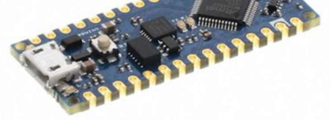
Before you start
Remember that the ADCS has an Arduino Nano Every (USB Micro).
IMPORTANT:
Keep the USB C connected to charge the battery for all the exercises since the ADCS draws a lot of current.
DO NOT UPLOAD ANY OF THE OBC PROGRAMS ON THE ADCS.

Slide 4



Reading one sun sensor
CREATE A NEW SKETCH CALLED
The ADCS can read values from 3 analog sun sensors (Adafruit ALS-PT19) placed inside the solar panels:
Look at the online documentation of the sun sensors and create a function to read one of them first to see what the output looks like in the serial monitor. Refer to the ADCS schematics to see the pin connection of the sensor.

Slide 5
Comparing the three sun sensors
CREATE A NEW SKETCH CALLED
The ADCS can read values from 3 analog sun sensors (Adafruit ALS-PT19) placed inside the solar panels:
Look at the online documentation of the sun sensors and create a function to read one of them first to see what the output looks like in the serial monitor. Refer to the ADCS schematics to see the pin connection of the sensor.
to face the sun. Create a function that compares the three sun sensors so that the serial monitor output looks like this:
THE CAMERA IS OBSERVING EARTH
or
THE SATELLITE POSITION NEEDS TO BE ADJUSTED
Use the flashlight to check it.

Slide 6
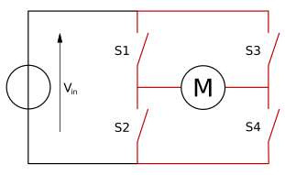
Driving the motor with an H-bridge
We have left, back, and right sun sensors with respect to the camera. We want to control the motor based on their values. The motor is controlled by a so-called H brid ge.
An H-bridge is an electronic circuit crucial for controlling the direction of DC motors. It consists of four switches arranged in an "H" shape, allowing the reversal of voltage polarity across the motor. By selectively closing switch pairs, the H-bridge can control the motor's rotation directionforward, reverse, or brake.

Slide 7
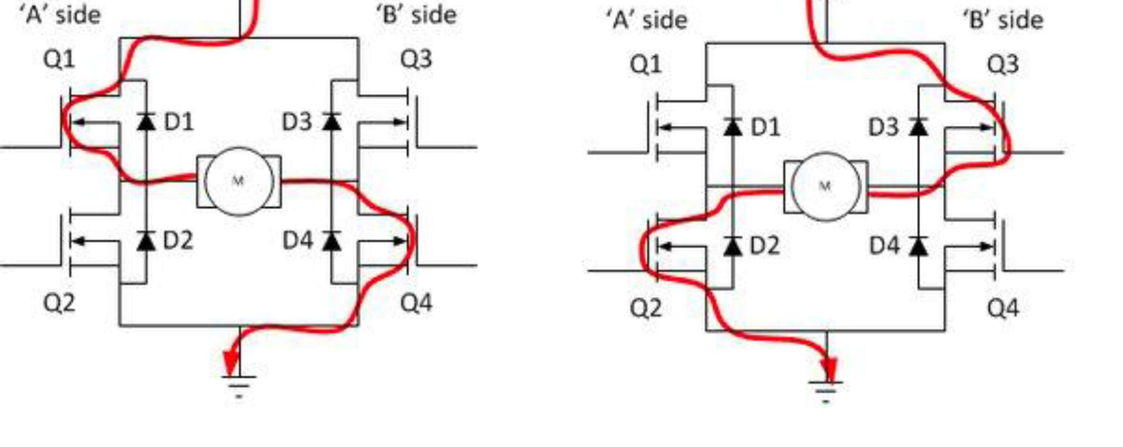
The H-bridge circuit

Slide 8

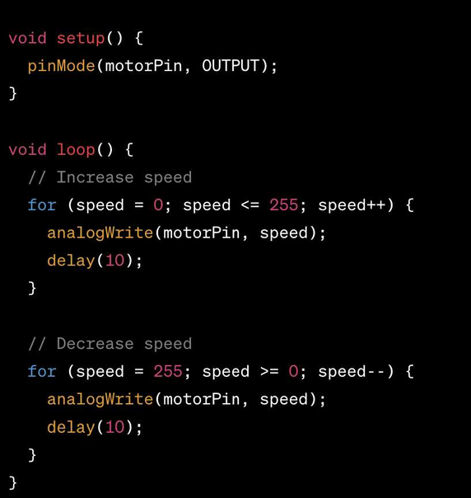
How to drive the motor correctly
This is how you correctly drive the motor:
Set up the pinMode as an OUTPUT.
Always use
.
Write a speed no higher than 255.
Keep a NEVER USE
at least.
.

Slide 9
Turning the wheel to the light
Write a function that:
If the left sensor has more light, the motor starts rotating counterclockwise for 1 second.
If the back sensor has more light, the motor is stopped.
If the right sensor has more light, the motor starts rotating clockwise for 1 second.
Include a Serial.print of the motor status (rotating ccw, rotating cw or stopped).
REMEMBER TO USE analogWrite(), NOT digitalWrite()
The maximum speed written has to be 255.
the sun sensor values.

Slide 10
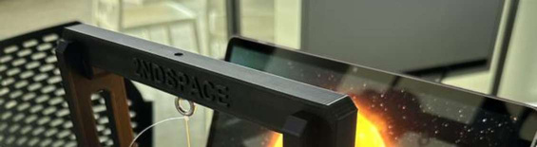
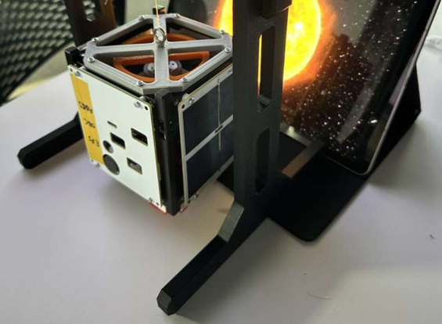
Testing on the stand
Test this function by hanging the satellite to the stand using the fishing line!
Once you tested it, un-hang the satellite for the next exercise.
eyebolts
and the

Slide 11
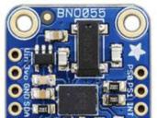

Reading the IMU
Now, comment out the motor and sun sensor parts.
The ADCS has an IMU module called Adafruit BNO055, refer to the ADCS schematics for the connections to the Arduino.
Using online documentation, write a function to read ALL the IMU outputs in the serial monitor.

Slide 12
Detecting a shake
Now, comment out the motor and sun sensor parts.
The ADCS has an IMU module called Adafruit BNO055, refer to the ADCS schematics for the connections to the Arduino.
Using online documentation, write a function to read ALL the IMU outputs in the serial monitor.
Look at the outputs to find the right threshold for the following exercise.
Create a function called shake() so that if the satellite is shaken, the motor starts rotating clockwise for 500ms and then counterclockwise for 500ms. The program should not repeat itself unless the satellite is shaken again.

Slide 13
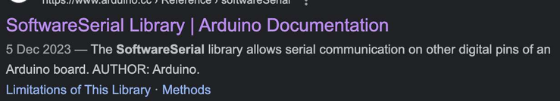
Linking the ADCS to the OBC
Although the ADCS Arduino controls its own sensors and motors, the only way to send commands to it or retrieve readings is by connecting it to the OBC Arduino. To achieve this, a dedicated serial communication link between the ADCS and OBC must be established.
Refer to the ADCS and OBC schematics to identify which pins are used for this serial connection.
By looking at the online documentation on Software Serial, write two separate codes (one to be uploaded on the ADCS, and one to be uploaded on the OBC
monitor.
DO NOT UPLOAD THE OBC CODE INTO THE ADCS

Slide 14
Reading the ADCS temperature
Although the ADCS Arduino controls its own sensors and motors, the only way to send commands to it or retrieve readings is by connecting it to the OBC Arduino. To achieve this, a dedicated serial communication link between the ADCS and OBC must be established.
Refer to the ADCS and OBC schematics to identify which pins are used for this serial connection.
By looking at the online documentation on Software Serial, write two separate codes (one to be uploaded on the ADCS, and one to be uploaded on the OBC
monitor.
Make this function callable from the OBC by typing 'TEMPADCS' into the serial
monitor.
DO NOT UPLOAD THE OBC CODE INTO THE ADCS

Slide 15
Driving the wheel from the OBC
, we activate the motor
movements, as specified below:
If the left sensor has more light, the motor starts rotating counterclockwise for 1 second.
If the back sensor has more light, the motor is stopped.
If the right sensor has more light, the motor starts rotating clockwise for 1 second.
Include a Serial.print of the motor status (rotating ccw, rotating cw or stopped).
REMEMBER TO USE analogWrite(), NOT digitalWrite()
The maximum speed written has to be 255.
the sun sensor values.

Slide 16
Detumbling
Include a function called detumbling() called by typing “DETUMB” that acts like this:
The motor should move back and forth for 2 seconds in each direction for a total time of 10 seconds and then stops completely. The maximum speed should be 255.
Include also a function that
If the satellite is shaken, a message should appear on the OBC saying: ANOMALY IN ACCELERATION!

